Slide 1

The Evolution of Remote Productivity (2020-2021)
Data-Driven Insights for the Post-Pandemic Workplace
Productivity is not just surviving; it is thriving.
Data from over 2,900 employees confirms that remote work acts as a productivity multiplier. The positive impact has accelerated over time, with Hybrid models showing the most significant maturation.

Slide 2



+18.6%
The Remote Productivity Multiplier
Average self-reported productivity increase in 2021, showcasing a significant acceleration from the initial pandemic baseline.
2021 Impact
Year-over-Year Growth
+18.6% Average Productivity Gain
Up from +13.0% in 2020
Methodology & Data Set
The analysis is based on a robust sample of nearly 3,000 employees comparing performance metrics across two distinct years of remote work adoption.
Total Sample
Dataset A (2020): 1,507 Employees
2,928
Dataset B (2021): 1,421 Employees
Metric: Self-reported % change vs. pre-remote baseline.
Employees surveyed across 2020 and 2021 to provide a longitudinal view.

Slide 3
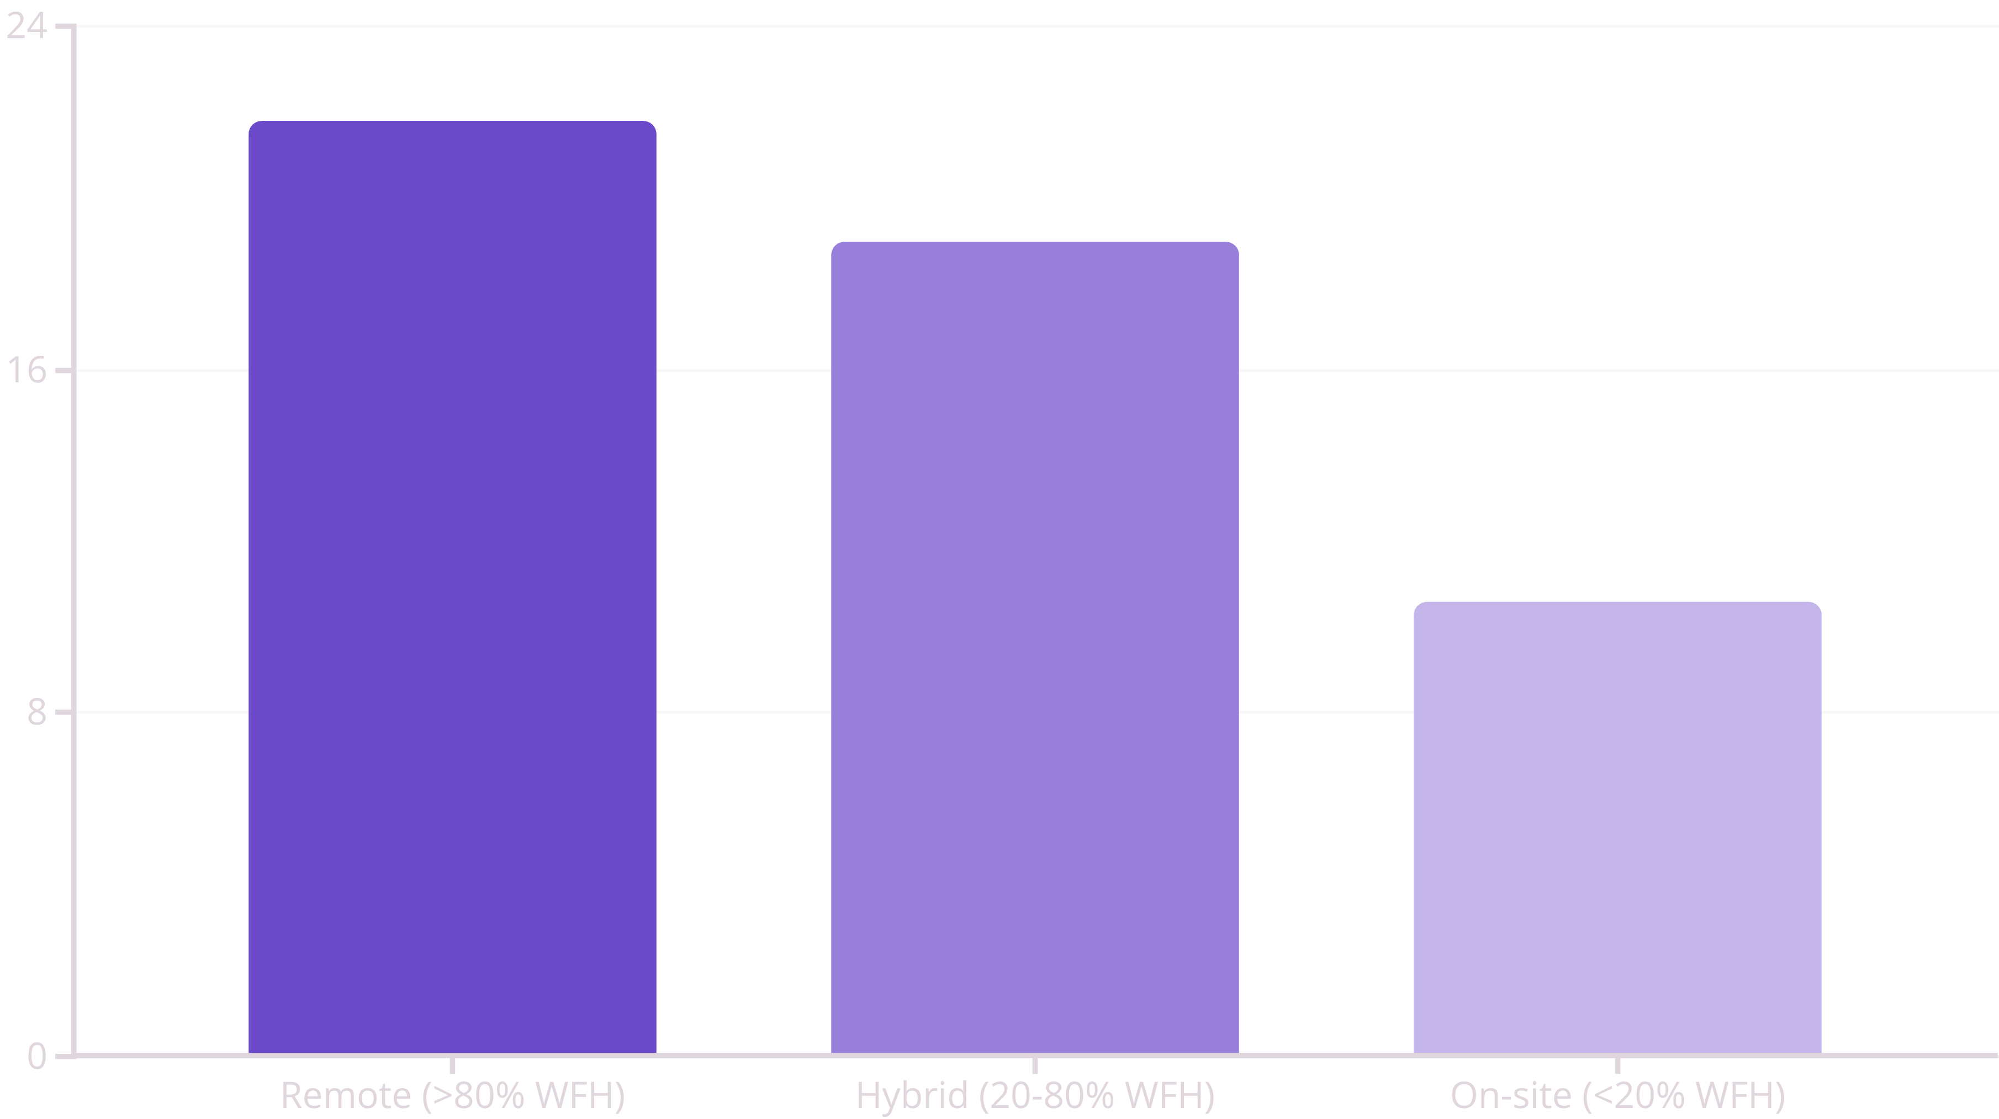
The Productivity Hierarchy: 2021 Snapshot
Remote work continues to deliver the highest efficiency gains, with Hybrid models quickly closing the gap as employees mastered new working environments.
Remote Workers: +21.8%
Hybrid Workers: +19.0%
On-site Workers: +10.6%
Highest gains driven by elimination of commute and enhanced environment control for deep work focus.
Enjoying the best of both worlds—social collaboration during office days and focused solo work remotely.
Even occasional remote work (<20%) is viewed as net-positive, lifting overall On-site productivity.

Slide 4



The "Maturity Leap": We Are Getting Better at Working Apart
Productivity scores improved across all work modes from 2020 to 2021, but Hybrid models demonstrated the fastest adoption and integration of new habits.
2020 Baseline
Hybrid: +10.5%
Remote: +16.0%
On-site: +8.3%
2021 Breakthrough
Hybrid: +19.0%
Remote: +21.8%
On-site: +10.6%
Hybrid's Acceleration: Highest Growth
The massive jump in Hybrid productivity (nearly doubling) suggests the "friction" of switching between home and office was largely resolved by 2021, proving it is a mature, sustainable model.

Slide 5

Policy Recommendation: Embracing Flexible Hybrid
The data confirms a shift in the distribution curve—fewer employees are losing productivity, and a large cluster are becoming "Super-Producers" (reporting +30% to +50% gains).
Remote Maximizes Output
Offers the highest raw output ceiling (+21.8%), enabling uninterrupted deep work critical for complex tasks.
Hybrid is Sustainable
Hybrid has shown the fastest rate of improvement, proving it is a sustainable, adaptable, and long-term strategy that balances needs.
Mitigate Productivity Risk
Pure On-site mandates risk losing the 10-20% "free" productivity bonus that employees feel when given control and flexibility.
Final Verdict
To maximize output, enable Deep Work via Remote days, and Collaboration via On-site days. The data proves employees have mastered the toolset for flexible work.

